Slide 1
UNIT 3
QUEUE

Slide 2
Queue
Queue is a linear list of elements in which deletion of an element can take place at one end, called the front and insertion can take place at the other end, called the rear.
The first element in a queue will be the first one to be removed from the list.
Queues are also called FIFO (First In First Out), i.e. the data item stored first will be accessed first.
The process to add an element into queue is called enqueue and the
process of removal of an element from queue is called dequeue.

Slide 3
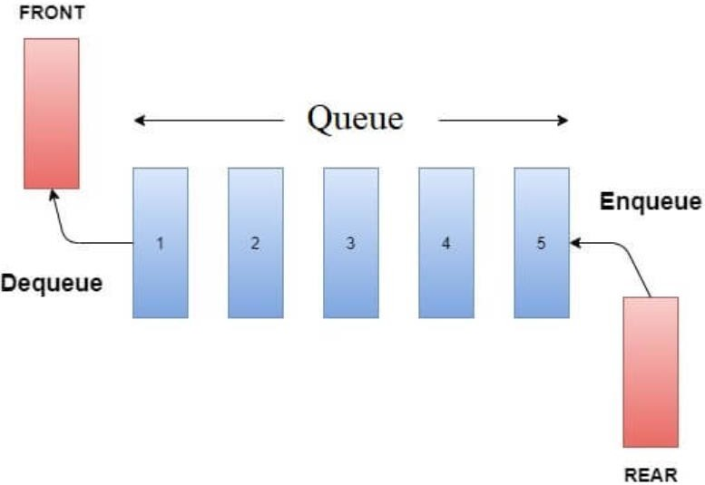
Queue Representation
In queue, we access both ends for different reasons.

Slide 4
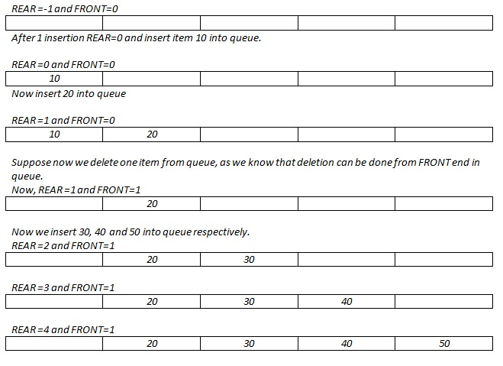
Queue Representation

Slide 5
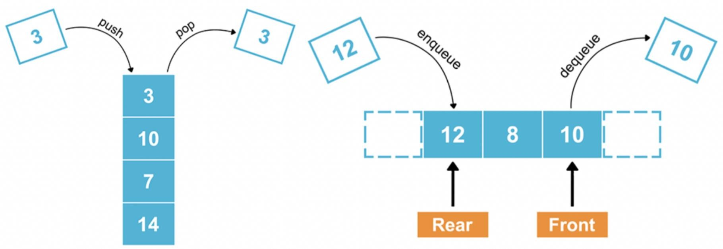
Stack vs. Queue Representation

Slide 6
Queue Operations
enqueue operation
It inserts the element at the end
(rear) of the queue.
isFull operation
Return true when the queue is full.
isEmpty operation
Return true when the queue is empty.
viewQueue operation
View all the elements in queue.
dequeue operation
It deletes the element from the
front of the queue.
getFront operation
It returns the element at the front
of the queue.
getRear operation
It returns the element at the end of the queue.

Slide 7
Queue as an ADT
A queue q of type T is a finite sequence of elements with the operations:
makeEmpty(q)
To make q as an empty queue
isEmpty(q)
To check whether the queue q is empty or not. Return true if q is empty and return false otherwise.
isFull(q)
To check whether the queue q is full or not. Return true if q is full and return false otherwise.
enqueue(q,x)
To insert an item x at the rear of the queue, if and only if q is not full.
dequeue(q)
To delete an item from the front of the queue q if and only if q is not empty.
traverse(q)
To read entire queue; i.e. display the content of the queue.

Slide 8
Queue Implementation
Creation of Queue
#define Maxsize 10
Struct Lqueue
{
int rear, front;
int item[Maxsize];
};
typedef Struct Lqueue qt;

Slide 9
Queue Implementation
Insertion Operation
void insert()
{
if(rear >= Maxsize -1)
{
printf("Queue is full");
}
else
{
int item;
rear= rear+1;
queue[rear] = item;
}
}
Algorithm
Start
Initialize front=0 & rear=-1
If rear>= Maxsize-1
print “ queue overflow”
otherwise
set rear= rear+1
queue[rear+1]= Item
4. Stop

Slide 10
Queue Implementation
Dequeue Operation
void del( )
{
if(rear < front)
{
printf("Queue is empty");
}
else
{
d= queue[front]
front= front+1
printf(“Dequeue item is %d”, d);
}
}
Algorithm
Start
If rear<front
print “ queue empty”
otherwise
set d= queue[front]
front= front+1
print “d” as dequeue item
4. Stop

Slide 11
Queue Implementation
Display / Traverse Operation
void traverse( )
{
if(rear < front)
{
printf("Queue is empty");
}
else
{
for(i=front; i<=rear; i++)
{
printf("%d\t",queue[i]);
}
}

Slide 12
Problem with Linear queue Why Circular Queue?
Implementation of a linear queue brings the drawback of memory wastage.
However, memory is a crucial resource that you should always protect by analyzing all the implications while designing algorithms or solutions.
In the case of a linear queue, when the rear pointer reaches the maxSize of a queue, there might be a possibility that after certain number of dequeue() operations, it will create empty space at the start of a queue.
To utilize the empty space, each dequeue() operation needs to be followed by shifting all elements once towards front.
This process will result in more time complexity.
Hence, experts introduced the concept of the circular queue to overcome this
limitation.

Slide 13
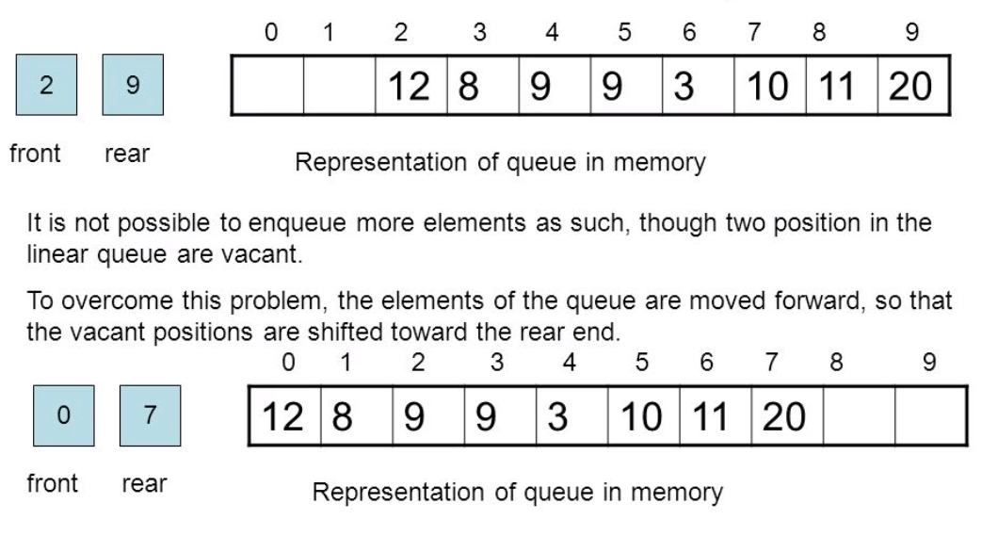
Possible solution

Slide 14
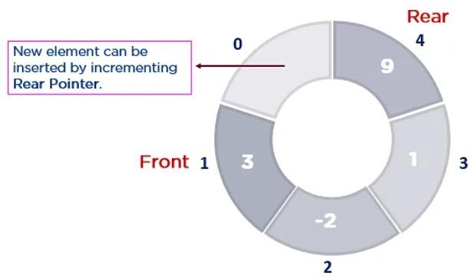
Circular Queue
A circular queue is an extended version of a linear queue as it follows the First In First Out (FIFO) principle with the exception that it connects the last node of a queue to its first by forming a circular link.
It is also called a Ring Buffer.

Slide 15
Operations in Circular Queue
Front – used to get the starting element of the circular queue
Rear – used to get the end element of the circular queue
enQueue(value) – used to insert a new value in the circular queue.This operation takes place from the end of the Queue.
deQueue() – used to delete a value from the circular queue. This operation takes place from the front of the Queue.

Slide 16
Operations in Circular Queue
enQueue(x) Operation:
This algorithm is assume that rear and front are initially set to MAZSIZE-1
Algorithm
1. if (front==(rear+1)%MAXSIZE)
print Queue is full and exit
else
rear=(rear+1)%MAXSIZE;
2. queue[rear]=item;
3.end

Slide 17
Operations in Circular Queue
enQueue(x) Operation:
void Enqueue(cq *q, int item){
if(front == (rear+1)%MAXSIZE) {
printf(“queue is full”);
exit(1);
}
else{
q->rear=(q->rear+1)%MAXSIZE;
q->items[q->rear]=newitem;
}
}

Slide 18
Operations in Circular Queue
deQueue(x) Operation:
This algorithm is assume that rear and front are initially set to MAZSIZE-1.1.
1. if (rear==front) [checking empty condition]
print Queue is empty and exit
2. front=(front+1)%MAXSIZE;
3. item=queue[front];
4. return item;
5. end

Slide 19
Operations in Circular Queue
deQueue(x) Operation:
int Dequeue(cq *q) {
if(q->rear < q->front){
printf(“queue is Empty”);
exit(1);
}
else{
q->front=(q->front+1)%MAXSIZE;
return(q->items[q->front]);
}
}

Slide 20
Linear Queue vs. Circular Queue
Linear Queue | Circular Queue
Arranges the data in a linear pattern. | Arranges the data in a circular order where the rear end is connected with the front end.
The insertion and deletion operations are fixed. i.e. done at the rear and front end. | Insertion and deletion are not fixed and it can be done in any position.
Linear queue requires more memory space. | Circular queue requires less memory space.
It is inefficient in comparison to circular queue. | It is more efficient in comparison to linear queue.
In a linear queue, peek value can be easily fetched. | Fetching peek value is not easy in circular queue.
Application: People standing for the bus. | Application: Computer – controlled traffic signal.

Slide 21
Applications of Queue
Some of the real world applications of queues are:
Cashier in line in any store
People in an escalator
Check in and check out at any book store
Some of the applications of queues related to computer science are:
Data getting transferred between the IO buffers (Input Output Buffers)
CPU scheduling and Disk scheduling
Managing shared resources between various processes
Job scheduling algorithms
Round Robin scheduling
Recognizing a palindrome
Traffic system

Slide 22

Priority Queue
Priority Queue is an ADT that performs operations on data elements per their priority.
The hospital emergency queue is an ideal real-life example of a priority queue.
In this queue of patients, the patient with the most critical situation is the first in a queue, and the patient who doesn’t need immediate medical attention will be at the last.
In this queue, the priority depends on
the medical condition of the patients.

Slide 23
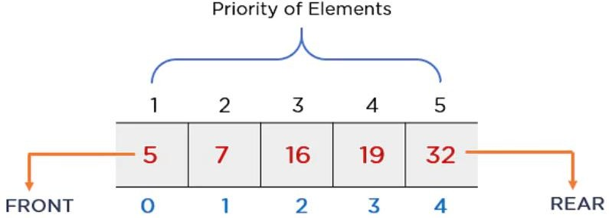
Priority Queue
It is highly used in sorting algorithms.
It behaves similar to a linear queue except for the fact that each element has some priority assigned to it.
The priority of element determines the order of removal in a queue; i.e. the element with higher priority will leave the queue first, whereas the element with the lowest priority at last or vice versa

Slide 24
Characteristics of Priority Queue
Every element has a certain priority assigned to it.
Every element of this queue must be comparable.
It will delete the element with higher priority before the element with lower priority and vice versa.
If multiple elements have the same priority, it does their removal from the queue according to the FCFS principle.

Slide 25
Types of Priority Queue
There are two types of priority queues based on the priority of elements:
If the element with the smallest value has the highest priority, then that priority queue is called the min priority queue (ascending).
If the element with the higher value has the highest priority, then that priority queue is called the max priority queue (descending).

Slide 26
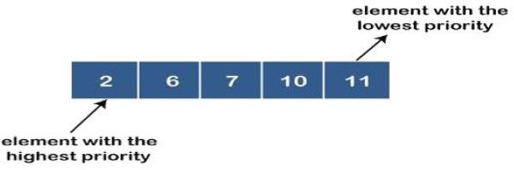
Types of Priority Queue
Ascending Priority Queue
In this type of priority queue, elements can be inserted into any order
but only the smallest element can be removed.
In ascending order priority queue, a lower priority number is given as a higher priority in a priority.
For example, we take the numbers arranged in an ascending order like 2, 6, 7, 10, 11; therefore, the smallest number, i.e. 2, is given as the highest priority in a priority queue.

Slide 27
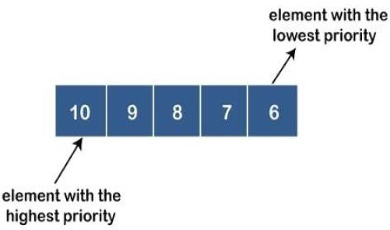
Types of Priority Queue
Descending Priority Queue
In this type of priority queue, elements can be inserted into any order but only
the largest element can be removed.
In descending order priority queue, a higher priority number is given as a higher priority in a priority.
For example, we take the numbers arranged in an descending order like 10, 9, 8, 7, 6; therefore, the smallest number, i.e. 10, is given as the highest priority in a priority queue.

Slide 28
Operations in Priority Queue
Inserting the element in a Priority Queue
void insert()
{
if(rear == Maxsize -1)
{
printf("Queue is full");
}
else
{
int item;
rear= rear+1;
queue[rear] = item;
}
}
Algorithm
Start
Initialize front=0 & rear=-1
If rear>= Maxsize-1
print “ queue overflow”
otherwise
set rear= rear+1
queue[rear+1]= Item
4. Stop

Slide 29
Operations in Priority Queue
Dequeue the element from a Priority Queue
void del (pq *q){
int i, temp=0, x;
x=q->item[q->front];
if(q->rear<q->front) {
printf("Queue is empty\n");
return 0;
}
else{
for(i =q->front+1; i< q->rear; i++) {
if(x>q->item[i])
{
temp= i;
x=q->item[i];
}
}
for(i= temp; i< q->rear-1; i++) {
q->item[i]=q->item[i+1];
}
q->rear--;
return x;
}
}

Slide 30
Application of Priority Queue
Priority queues are used in many computing applications.
For example, many operating systems uses a scheduling algorithm where the next process executed is the one with the shortest execution time or the highest priority.
For another example, consider the problem of sorting a file of data
representing persons.
We can first add all the persons to a queue
Sort data in certain order according to the specified priority, and then
Remove them in turn from the priority queue (front element first).
The best application of priority queue is observed in CPU scheduling. A short job is given higher priority over the longer one.

